Slide 1
Age of Exploration
Part 6 – More European Countries Explore America

Slide 2
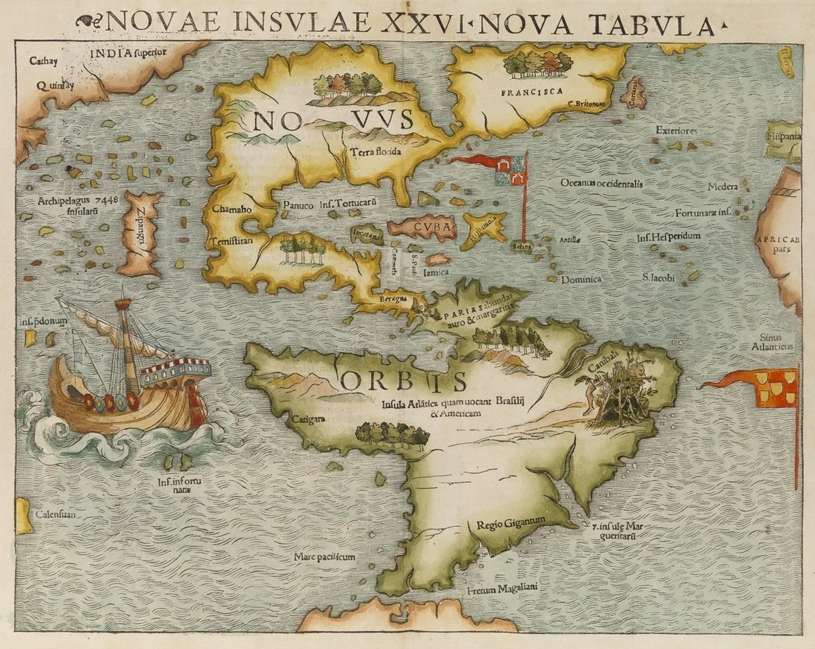
More European countries sent out explorers to find a way around America to get to Asia.

Slide 3
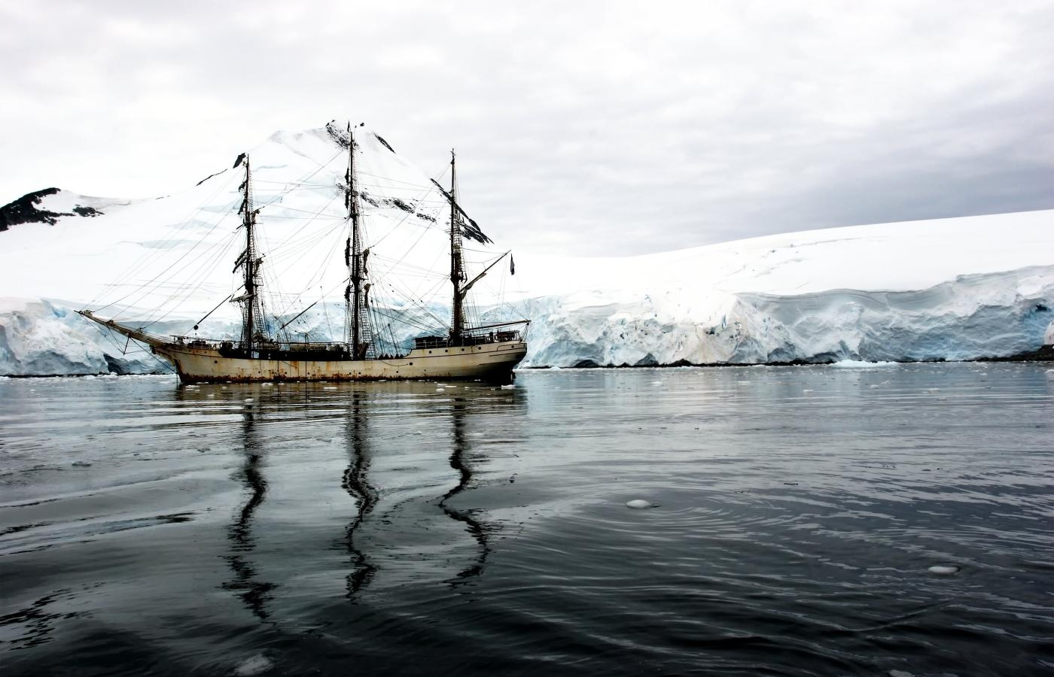
Europeans were looking for the Northwest Passage, a waterway through or around North America.

Slide 4
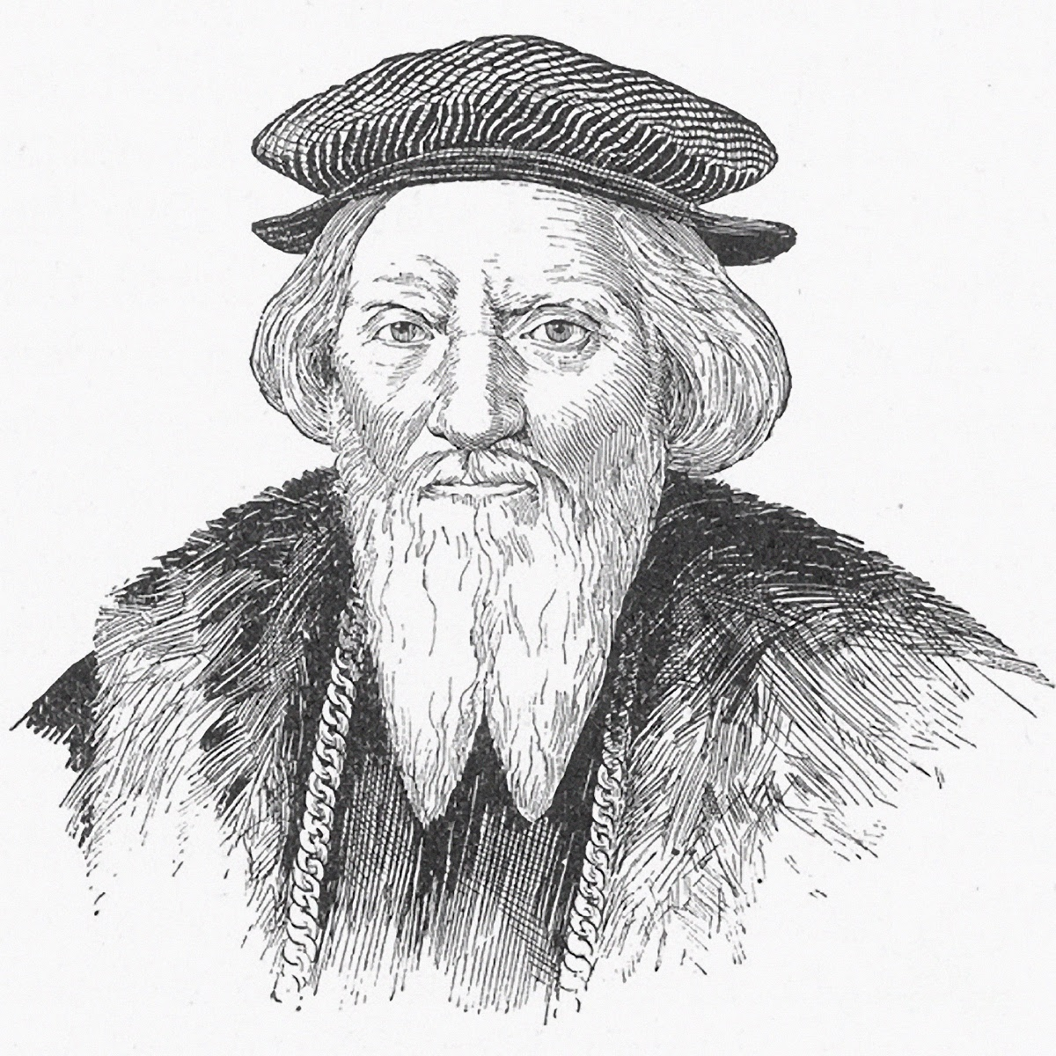
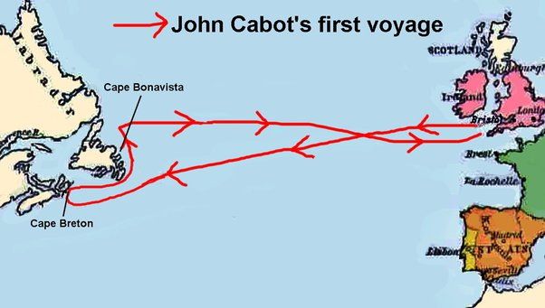
John Cabot sailed to America in 1497 for England after hearing about Columbus’s voyage. He thought he was going to Asia.

Slide 5
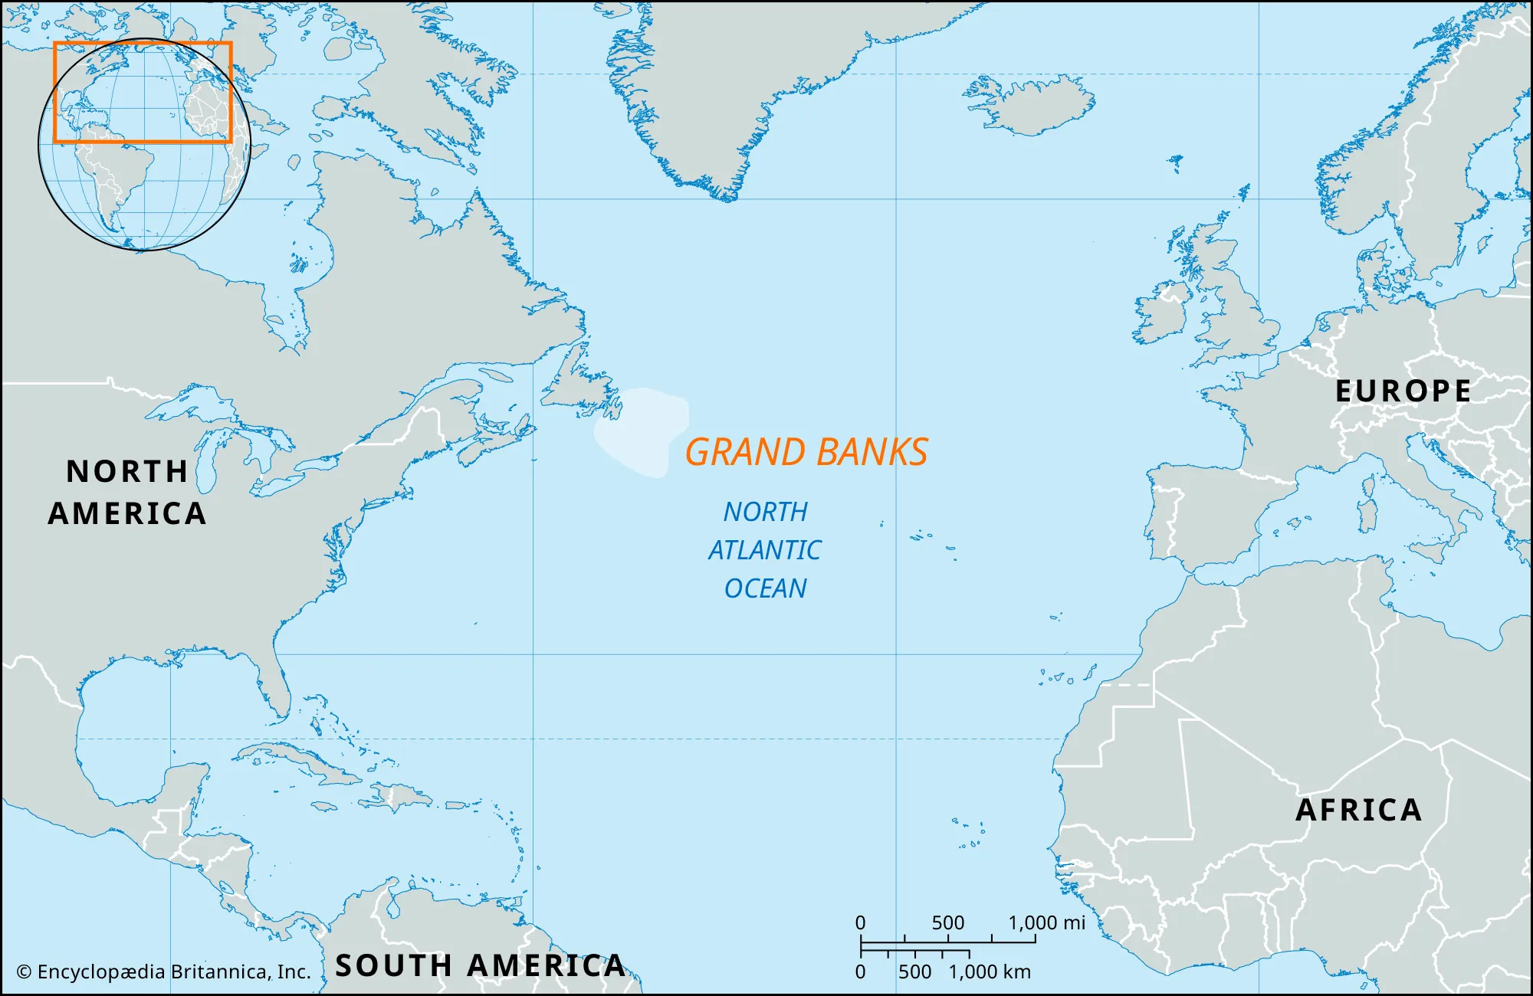
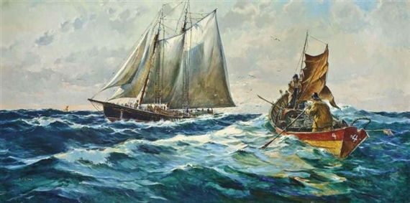
Cabot landed in northern North America, discovered vast forests and the Grand Banks, a rich fishing area off the coast of Newfoundland.

Slide 6
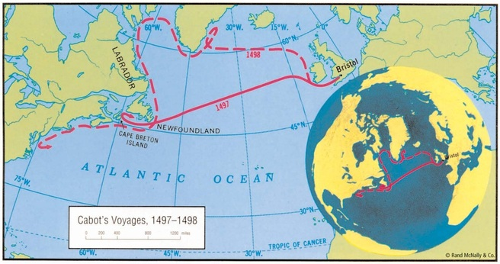
Cabot sailed west again in 1498 in hopes of making it to Japan but was never heard from again.

Slide 7
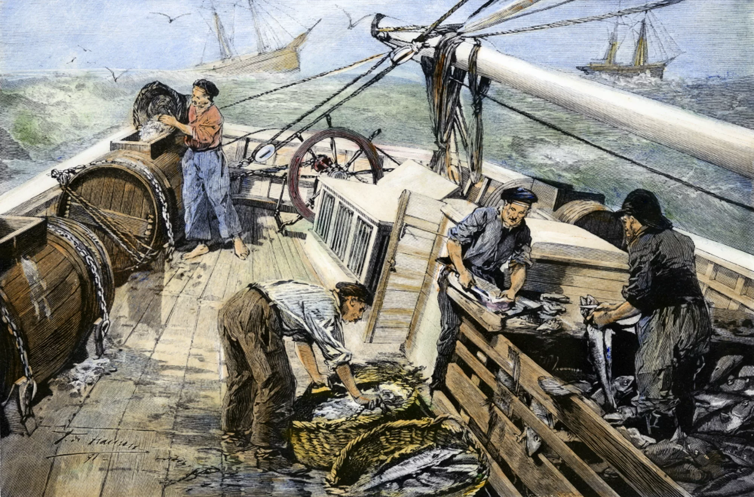
Cabot’s discovery, though, led to a new wealth- fish. Every spring, fishermen from England, France, and Holland crossed the Atlantic in hopes of filling their ships with fish to take back to Europe.

Slide 8
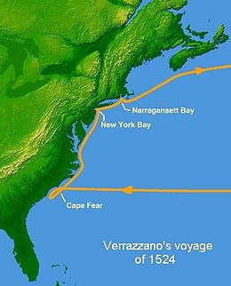
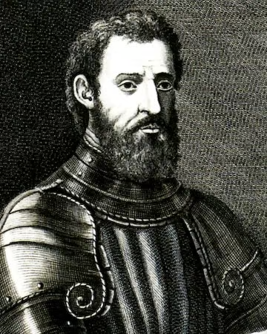
In 1524, Giovanni da Verrazano made a voyage for France looking for the Northwest Passage. He ended up exploring the east coast of America from North Carolina north to Canada. He was the first European to explore New York Bay.

Slide 9
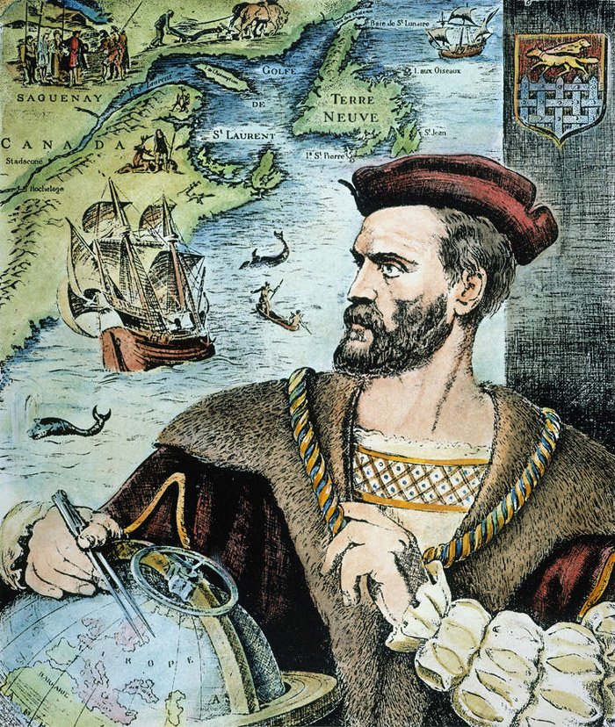
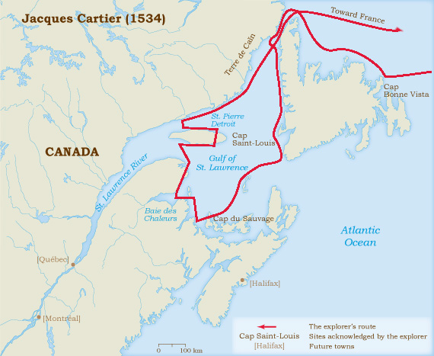
In 1534, Jacques Cartier, also exploring for France, voyaged to the Gulf of St. Lawrence and ended up capturing two Native Americans.

Slide 10
The following year, Cartier returned and sailed up the St. Lawrence River for hundreds of miles. He never found the Northwest Passage, but his exploration ended up being the basis for French claims to the lands around the St. Lawrence River.

Slide 11
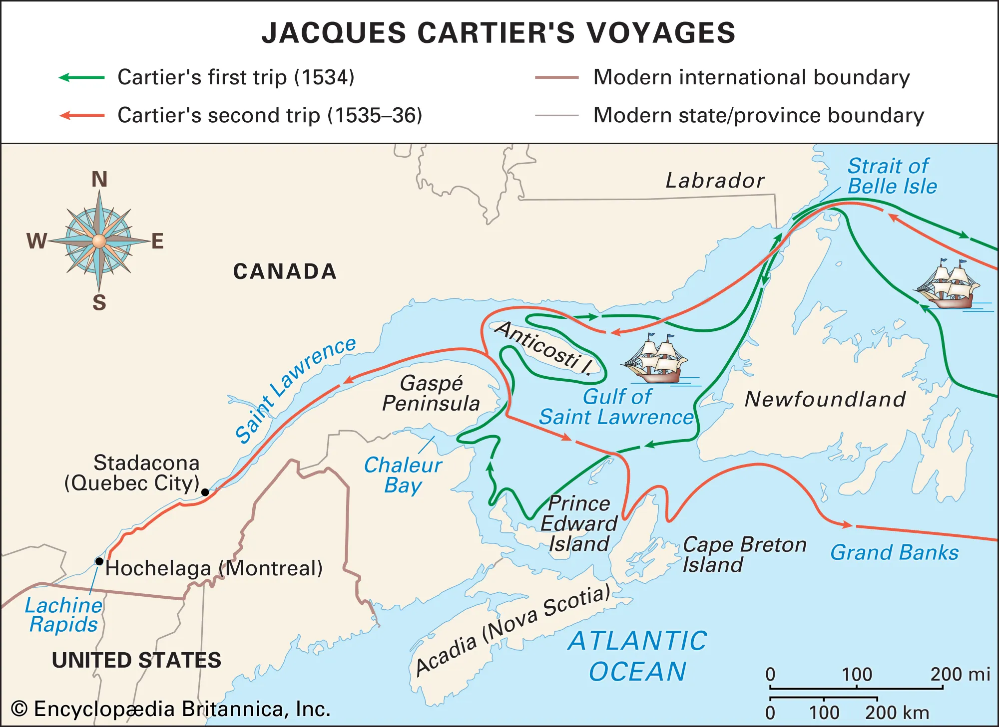

Slide 12
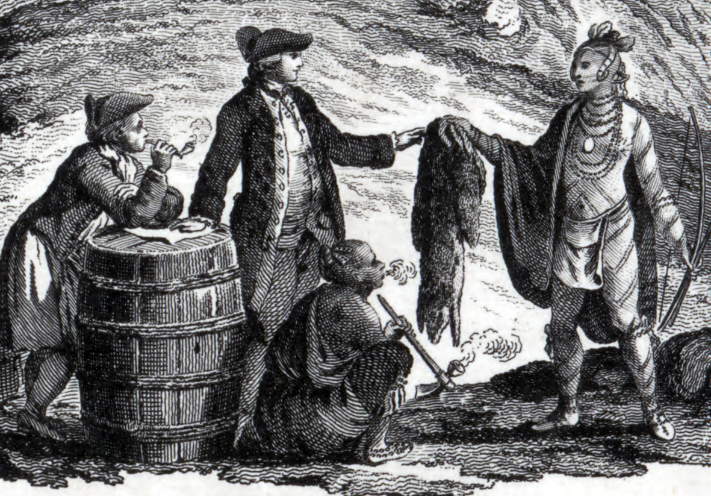
In 1608, Samuel de Champlain, a French captain, explored the area around the St. Lawrence River. He established a fur-trading post that he named Quebec. It was the first permanent French settlement in North America.

Slide 13
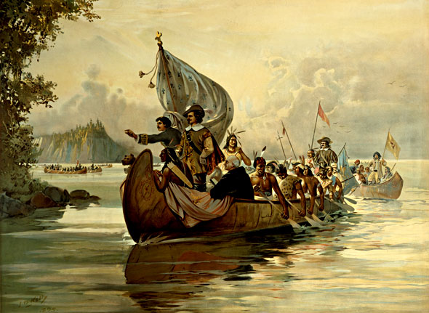
Champlain traveled further inland, learning more about the region and the Native Americans who lived there. His explorations were the beginning of the French colonization in North America.

Slide 14
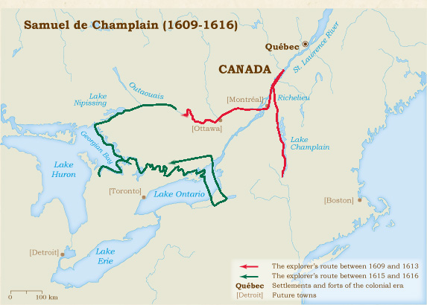

Slide 15
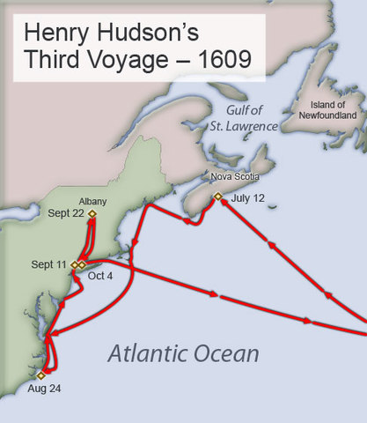
In 1609, Dutch merchants hired Englishman, Henry Hudson to find a water route to China. He traveled up the Hudson River to what is now Albany, NY. The Dutch would go on to settle in this region.

Slide 16
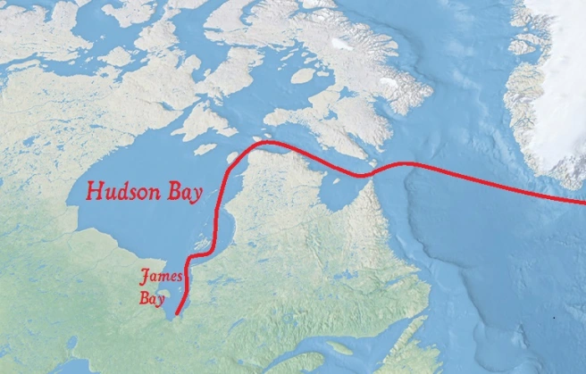
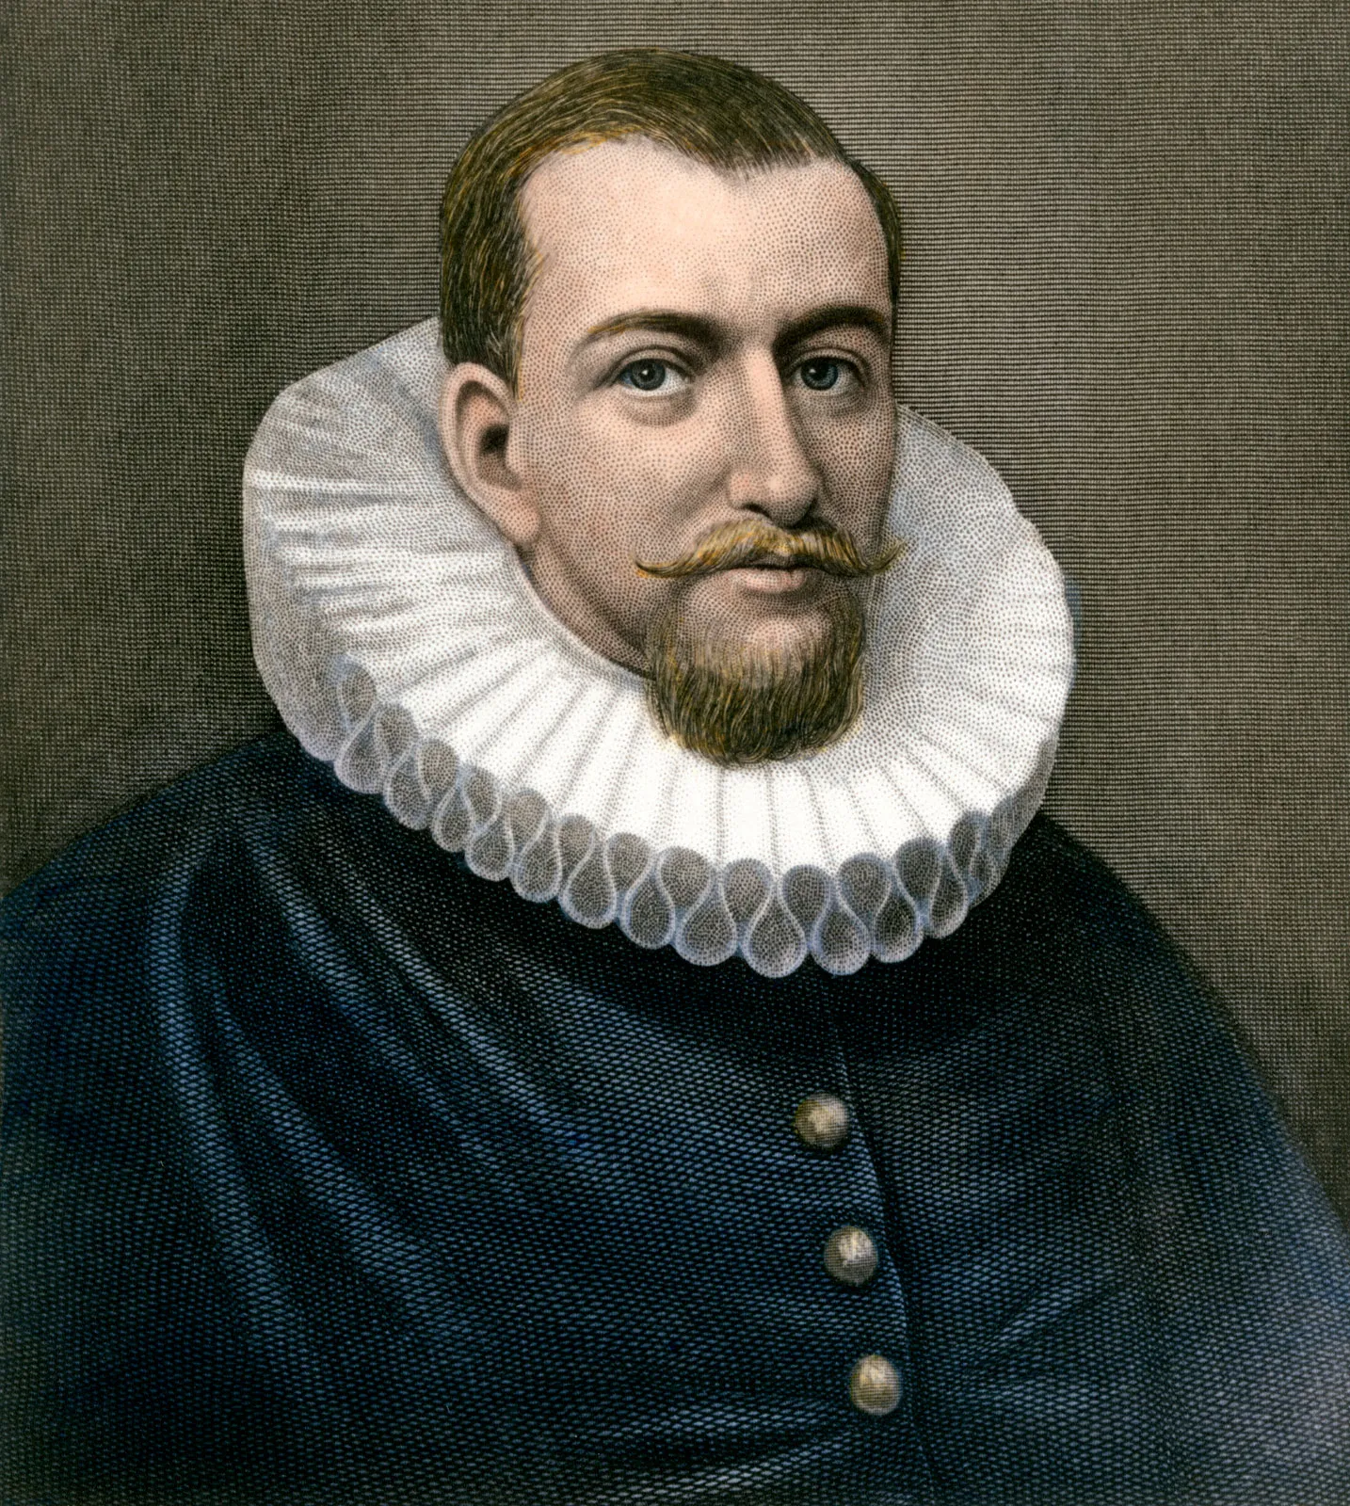
The following year, 1610, he sailed for China again, this time for England. He ended up sailing into and exploring the Hudson Bay.

Slide 17
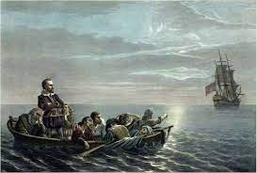
After a difficult winter, his crew revolted. They forced Hudson, his young son, and a few loyal crew members onto a small boat and set it adrift. They were never heard from again.

Slide 18
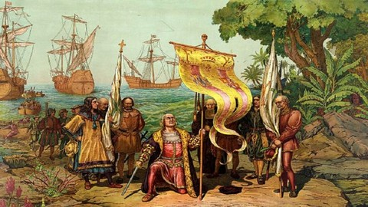
These explorers never found the Northwest Passage, but they did do something very important. Their discoveries turned the attention of Europe from Asia to America.

